Slide 1


Python for Game Development
Welcome to the world of game development with Python! Today we'll explore the exciting process of creating a game using this versatile language. From setting up the environment to deploying your finished product, we'll cover all the essential steps.
by Hammad zahid

Slide 2
Why Python for Game Development?
Ease of Learning
Extensive Libraries
Strong Community
Python's beginner-friendly syntax makes it easy to pick up, even for those new to programming.
Python boasts a wealth of libraries specifically designed for game development, simplifying tasks and saving time.
A large and active community provides ample support, resources, and solutions to common development challenges.

Slide 3
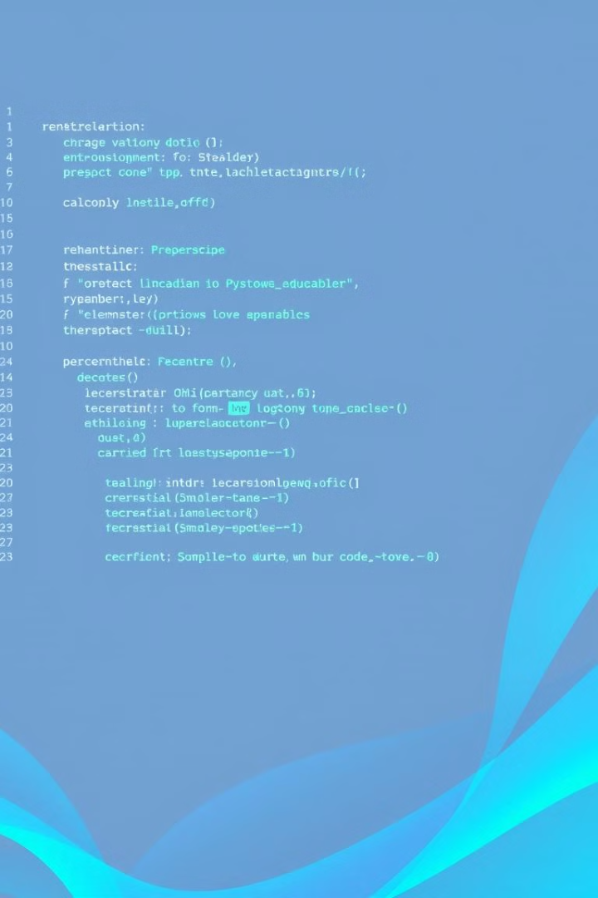
Fundamentals of Python Programming
Variables
Data Types
Variables store data within your game, allowing you to manage things like player scores, object positions, and game states.
Python supports various data types, including numbers, strings, lists, and dictionaries, each serving specific purposes in your game.
Control Flow
Control flow structures like loops and conditional statements govern the execution of your game logic, creating dynamic and interactive gameplay.

Slide 4
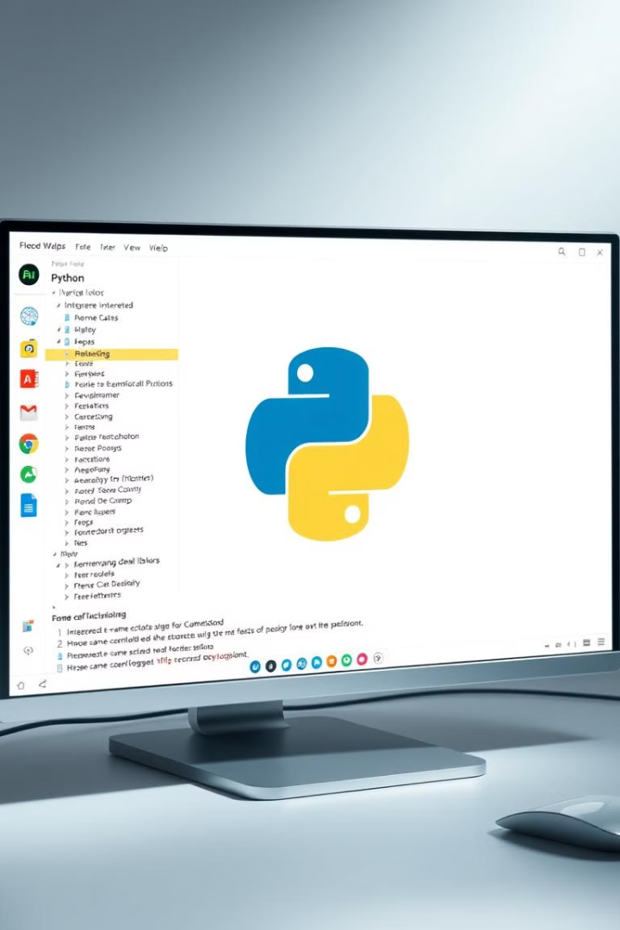



Setting Up the Game Environment
Install Python
Download and install the latest Python version from the official website.
Choose a Framework
Select a suitable game development framework like Pygame or Panda3D, depending on your project's needs.
Install Libraries
Use the pip package manager to install any necessary libraries, such as those for graphics, sound, and physics.

Slide 5
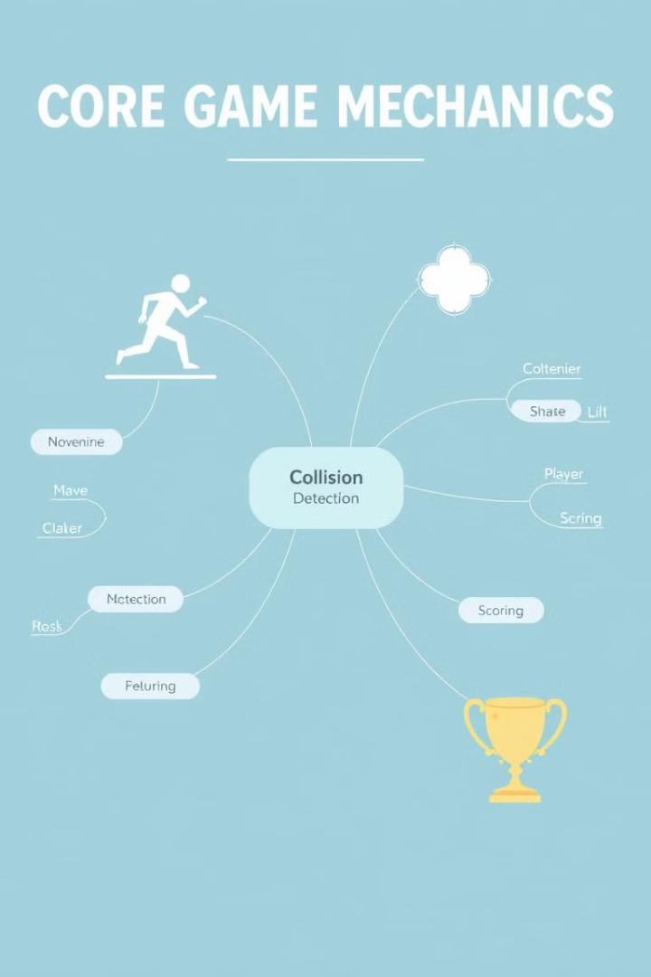
Designing the Game Mechanics
1
Define the player's role, movement, and interactions within the game world.
2
Determine the game's objectives, challenges, and how players achieve success.
3
Plan the game's levels, obstacles, rewards, and overall progression structure.

Slide 6
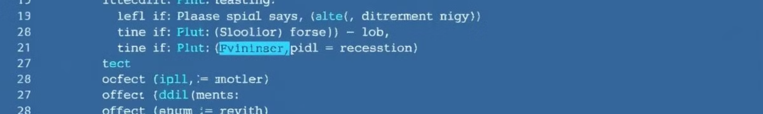



Implementing Game Logic and Interactivity
Input Handling
Use Python to handle player input, like keyboard presses or mouse clicks, to control game actions.
Collision Detection
Implement collision detection algorithms to determine when objects interact, triggering specific events or behaviors.
Game State Management
Manage the game's state, including player lives, scores, and level progression, using variables and conditional statements.

Slide 7
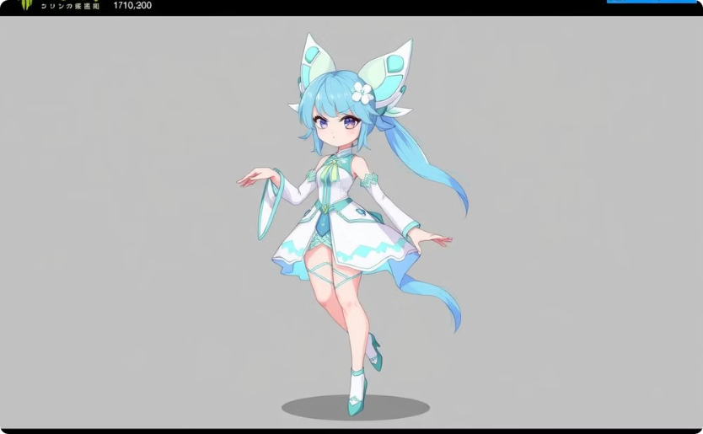
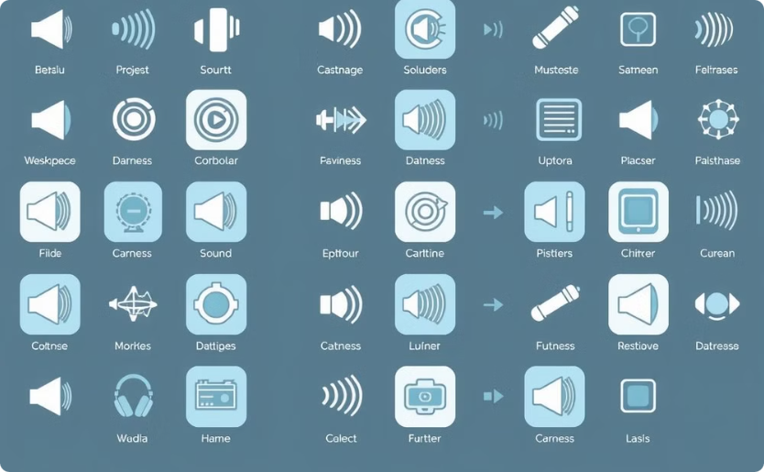
Incorporating Graphics and Sound Effects
Sprite Creation
Sound Integration
Design and create sprites using image editing software or Python libraries.
Integrate sound effects and background music using Python libraries to enhance the game's atmosphere.

Slide 8



Optimizing and Debugging the Game Code
Profiling
1
Analyze code performance to identify bottlenecks and areas for optimization.
Optimization Techniques
2
Implement techniques like code refactoring, data structures, and algorithms to improve efficiency.
Debugging
3
Use debugging tools and techniques to identify and fix errors in your code.

Slide 9
Deploying and Sharing Your Python Game
Choose a Platform
1
Determine your target platform: desktop, mobile, or web.
Packaging
2
Package your game code into an executable file or web application.
Distribution
3
Upload your game to online stores or websites for players to download and enjoy.

